Slide 1
15CSE402
Structure and Interpretation of Computer Programs
Higher-Order Procedures

Slide 2
Limitations of common procedures
Numerical processing will be severely limited in the ability to create abstractions if restricted to procedures whose parameters
are only numbers
The same programming pattern will be used with a number of different procedures
Procedures which accept procedures as arguments are needed.

Slide 3
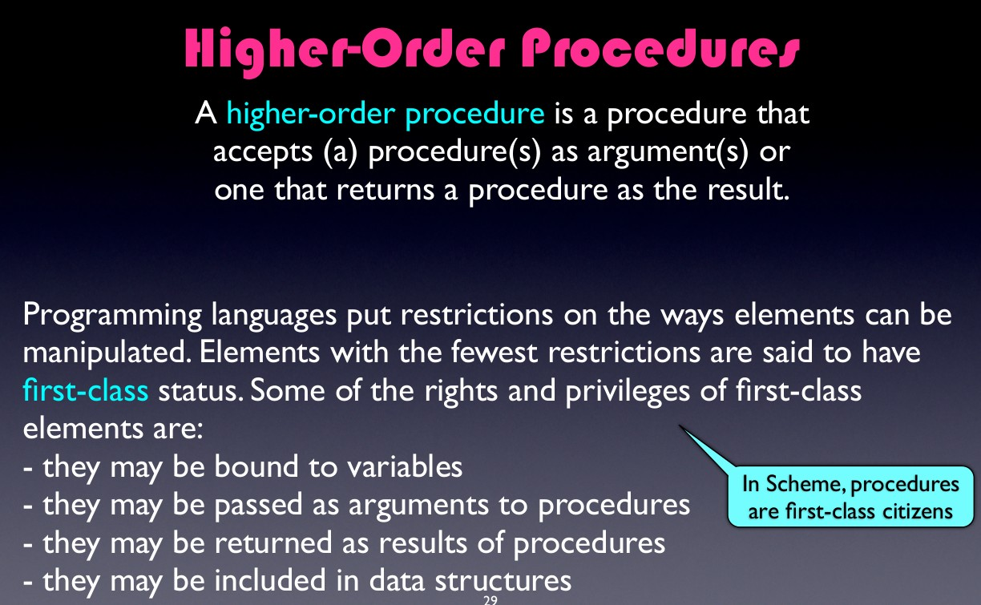

Slide 4
Sum of Integers from
a through b
a = 1
b = 5
sum-integers = 1 + 2 + 3 + 4 + 5

Slide 5
Sum of Integers from
a through b
(define (sum-integers a b) (if (> a b)
0
(+ a (sum-integers (+ a 1) b))))

Slide 6
Sum of Cubes from
a through b
(define (sum-cubes a b) (if (> a b)
0
(+ (cube a) (sum-cubes (+ a 1) b))))

Slide 7
Sum of Sequence of Terms in Series
1 ₊ 1 ₊ 1 _{+⋯}
1⋅3 5⋅7 9⋅11
converges to π/8 (very slowly)

Slide 8
Sum of Sequence of Terms in Series
(define (pi-sum a b) (if (> a b)
0
(+ (/ 1.0 (* a (+ a 2)))
(pi-sum (+ a 4) b))))

Slide 9
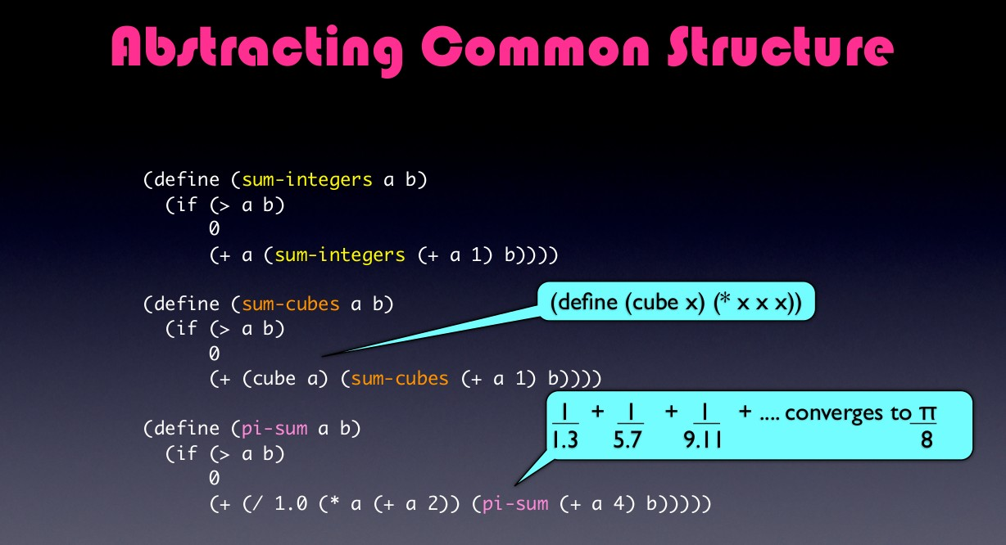

Slide 10
Identifying Common Structure
(define (sum-integers a b) (if (> a b)
0
(+ a (sum-integers (+ a 1) b))))
(define (sum-cubes a b) (if (> a b)
0
(+ (cube a) (sum-cubes (+ a 1) b))))
(define (pi-sum a b) (if (> a b)
0
(+ (/ 1.0 (* a (+ a 2))) (pi-sum (+ a 4) b))))

Slide 11
Identifying Common Structure
The three procedures clearly share a common underlying pattern and are identical for most part
Differ in
the name of the procedure
the function of a used to compute the term to be added
the function that provides the next value of a

Slide 12
Abstracting Common Structure
(define (<name> a b) (if (> a b)
0
(+ (<term> a) (<name> (<next> a) b))))

Slide 13
Abstracting Common Structure
(define (sum-integers a b) (if (> a b)
0
(+ a (sum-integers (+ a 1) b))))
(define (sum-cubes a b) (if (> a b)
0
(+ (cube a) (sum-cubes (+ a 1) b))))
(define (pi-sum a b) (if (> a b)
0
(+ (/ 1.0 (* a (+ a 2))) (pi-sum (+ a 4) b))))

Slide 14
Abstracting Common Structure
sum
(define (sum-integers a b) (if (> a b)
0
(+ a (sum-integers (+ a 1) b))))
(define (sum-cubes a b) (if (> a b)
0
(+ (cube a) (sum-cubes (+ a 1) b))))
(define (pi-sum a b) (if (> a b)
0
(+ (/ 1.0 (* a (+ a 2))) (pi-sum (+ a 4) b))))

Slide 15
Abstracting Common Structure
(define (sum-integers a b) (if (> a b)
0
(+ a (sum-integers (+ a 1) b))))
(define (sum-cubes a b) (if (> a b)
0
(+ (cube a) (sum-cubes (+ a 1) b))))
(define (pi-sum a b) (if (> a b)
0
(+ (/ 1.0 (* a (+ a 2))) (pi-sum (+ a 4) b))))

Slide 16
Abstracting Common Structure
(define (sum-integers a b)
term
(if (> a b)
0
(+ a (sum-integers (+ a 1) b))))
(define (sum-cubes a b) (if (> a b)
0
(+ (cube a) (sum-cubes (+ a 1) b))))
(define (pi-sum a b) (if (> a b)
0
(+ (/ 1.0 (* a (+ a 2))) (pi-sum (+ a 4) b))))

Slide 17
Abstracting Common Structure
(define (sum-integers a b) (if (> a b)
0
(+ a (sum-integers (+ a 1) b))))
(define (sum-cubes a b) (if (> a b)
0
(+ (cube a) (sum-cubes (+ a 1) b))))
(define (pi-sum a b) (if (> a b)
0
(+ (/ 1.0 (* a (+ a 2))) (pi-sum (+ a 4) b))))

Slide 18
Abstracting Common Structure
next
(define (sum-integers a b) (if (> a b)
0
(+ a (sum-integers (+ a 1) b))))
(define (sum-cubes a b) (if (> a b)
0
(+ (cube a) (sum-cubes (+ a 1) b))))
(define (pi-sum a b) (if (> a b)
0
(+ (/ 1.0 (* a (+ a 2))) (pi-sum (+ a 4) b))))

Slide 19
Abstracting Common Structure
sum
(define (sum-integers a b) (if (> a b)
0
(+ a (sum-integers (+ a 1) b))))
next
term
(define (sum-cubes a b) (if (> a b)
0
(+ (cube a) (sum-cubes (+ a 1) b))))
(define (pi-sum a b) (if (> a b)
0
(+ (/ 1.0 (* a (+ a 2))) (pi-sum (+ a 4) b))))

Slide 20
Abstracting Common Structure
(define ( a b)
(if (> a b)
0
(+ (
sum-integers
a
sum-integers (+ a 1)
b))))
(define (
(if (> a b)
sum-cubes
a b)
0 (+
(cube a)
(
sum-cubes (+ a 1)
b))))
(define (
(if (> a b)
pi-sum
a b)
0 (+
(/ 1.0 (* a (+ a 2)))
(
pi-sum (+ a 4)
b))))

Slide 21
Procedures as Arguments
(define ( a b) (if (> a b)
0
(+ ( a) ( ( a) b))))

Slide 22
Abstracting Common Structure
sum
(define (sum-integers a b) (if (> a b)
0
(+ a (sum-integers (+ a 1) b))))
(define (sum-cubes a b) (if (> a b)
0
(+ (cube a) (sum-cubes (+ a 1) b))))
(define (pi-sum a b) (if (> a b)
0
(+ (/ 1.0 (* a (+ a 2))) (pi-sum (+ a 4) b))))

Slide 23
Abstracting Common Structure
(define (<name> a b) (if (> a b)
0
(+ (<term> a) (<name> (<next> a) b))))

Slide 24
Procedures as Arguments
(define (sum a b) (if (> a b)
0
(+ ( a) (sum ( a) b))))

Slide 25
Abstracting Common Structure
(define (sum-integers a b)
term
(if (> a b)
0
(+ a (sum-integers (+ a 1) b))))
(define (sum-cubes a b) (if (> a b)
0
(+ (cube a) (sum-cubes (+ a 1) b))))
(define (pi-sum a b) (if (> a b)
0
(+ (/ 1.0 (* a (+ a 2))) (pi-sum (+ a 4) b))))

Slide 26
Procedures as Arguments
(define (sum term a b) (if (> a b)
0
(+ (term a) (sum term ( a) b))))

Slide 27
Abstracting Common Structure
next
(define (sum-integers a b) (if (> a b)
0
(+ a (sum-integers (+ a 1) b))))
(define (sum-cubes a b) (if (> a b)
0
(+ (cube a) (sum-cubes (+ a 1) b))))
(define (pi-sum a b) (if (> a b)
0
(+ (/ 1.0 (* a (+ a 2))) (pi-sum (+ a 4) b))))

Slide 28
Procedures as Arguments
(define (sum term a next b) (if (> a b)
0
(+ (term a) (sum term (next a) next b))))

Slide 29
Sum of Integers from
a through b
(define (sum-integers a b) (if (> a b)
0
(+ a (sum-integers (+ a 1) b))))

Slide 30
Sum-Integers
(define (sum term a next b) (if (> a b)
0
(+ (term a) (sum term (next a) next b))))
(define (identity x) x)
(define (inc n) (+ n 1))
(define (sum-integers a b) (sum identity a inc b))

Slide 31
Sum of Cubes from
a through b
(define (sum-cubes a b) (if (> a b)
0
(+ (cube a) (sum-cubes (+ a 1) b))))

Slide 32
Sum-Cubes
(define (sum term a next b) (if (> a b)
0
(+ (term a) (sum term (next a) next b))))
(define (cube x) (* x x x))
(define (inc n) (+ n 1))
(define (sum-cubes a b) (sum cube a inc b))

Slide 33
Sum of Sequence of Terms in Series
(define (pi-sum a b) (if (> a b)
0
(+ (/ 1.0 (* a (+ a 2)))
(pi-sum (+ a 4) b))))

Slide 34
Pi-Sum
(define (sum term a next b) (if (> a b)
0
(+ (term a) (sum term (next a) next b))))
(define (pi-term x) (/ 1.0 (* x (+ x 2)))) (define (pi-next x) (+ x 4))
(define (pi-sum a b)
(sum pi-term a pi-next b))

Slide 35
Abstracting Common Structure
(define (sum term a next b) (if (> a b)
0
(+ (term a) (sum term (next a) next b))))
(define (sum-integers a b) (sum identity a inc b))
(define (sum-cubes a b)
(sum cube a inc b))
(define (pi-sum a b)
(sum pi-term a pi-next b))

Slide 36
Example of Re-use
b
dx dx dx
∫ f =[ f (a+ ₂ )+ f (a+ dx + ₂ )+ f (a +2dx+ ₂ )+⋯] dx
a
(define (sum term a next b)
(if (> a b)
0
(+ (term a) (sum term (next a) next b))))

Slide 37
Example of Re-use
b
dx dx dx
∫ f =[ f (a+ ₂ )+ f (a+ dx + ₂ )+ f (a +2dx+ ₂ )+⋯] dx
a
(define (integral f a b dx)
(* (sum f (+ a (/ dx 2.0)) add-dx b) dx))
(define (add-dx x) (+ x dx))

Slide 38
Example of Re-use
b
dx dx dx
∫ f =[ f (a+ ₂ )+ f (a+ dx + ₂ )+ f (a +2dx+ ₂ )+⋯] dx
a
(define (integral f a b dx)
(* (sum f (+ a (/ dx 2.0)) add-dx b) dx))
(define (add-dx x) (+ x dx)) (integral cube 0 1 0.01)

Slide 39
Constructing Nameless Procedures using Lambda

Slide 40
Lambda Special Form
(define (pi-term x)
(/1.0 (* x (+ x 2))))
(define (pi-next x)
(+ x 4))
(lambda (x)
(/ 1.0 (* x (+ x 2))))
(lambda (x) (+ x 4))

Slide 41
Rewriting pi-sum using lambda
(define (pi-sum a b) (if (> a b)
0
(+ (/ 1.0 (* a (+ a 2)))
(pi-sum (+ a 4) b))))
(define (pi-sum a b)
(sum
(lambda (x) (/ 1.0 (* x (+ x 2))))
a
(lambda (x) (+ x 4))
b))
(define (pi-sum a b)
(sum pi-term a pi-next b))

Slide 42
Integral Procedure using Lambda
(define (integral f a b dx)
(* (sum f (+ a (/ dx 2.0)) add-dx b) dx))
(define (add-dx x) (+ x dx))
(define (integral f a b dx)
(* (sum f (+ a (/ dx 2.0)) (lambda (x) (+ x dx)) b) dx))

Slide 43
Lambda – Nameless procedures
Syntax:
(lambda (<formal-parameters>) <body>)
Comparison with define:
(define (plus4 x) (+ x 4))
Equivalent to
(define plus4 (lambda (x) (+ x 4)))

Slide 44
Reading a Lambda Expression:
Not associated with any name in an environment like procedures created using define
(lambda (x) (+ x 4))
| | | | |
the procedure of an argument x that adds x and 4

Slide 45
Using Lambda Expression as an operator in Combinations
((lambda (x y z) (+ x y (square z))) 1 2 3)
12

Slide 46
Using let to Create Local
Variables

Slide 47
Using Lambda to create local variables other than formal parameters
Example:
f (x, y) = x(1 + x y)² + y(1 – y) + (1 + x y)(1 – y))
x, y, a, b – Local variables
a = 1 + x y
b = 1 – y
f (x, y) = xa² + yb + ab

Slide 48
Writing a procedure for f using local variables
Method 1: Auxiliary Procedure
Method 2: lambda Procedure
(define (f x y)
(define (f-helper a b)
(+ (* x (square a))
(* y b)
(* a b)))
(f-helper (+ 1 (* x y))
(- 1 y)
)
)
(define (f x y)
((lambda (a b)
(+ (* x (square a))
(* y b)
(* a b)))
(+ 1 (* x y))
(- 1 y)))
Method 3: Internal Definitions
Method 4: Let (Special Form)
(define (f x y)
(define a (+ 1 (* x y)))
(define b (- 1 y))
(+ (* x (square a))
(* y b)
(* a b)))
(define (f x y)
( let ((a (+ 1 (* x y)))
(b (- 1 y)))
(+ (* x (square a))
(* y b)
(* a b))))

Slide 49
The Let Expression
let <var₁> have the value <exp₁> and
<var₂> have the value <exp₂> and
...
<var_{n}> have the value <exp_{n}>
in <body>
General Form:
( let ( (<var₁> <exp₁>)
(<var₂> <exp₂>)
...
(<var_{n}> <exp_{n}>)
)
<body>
)
Alternate Expression !
A let expression is simply syntactic sugar for the underlying
lambda application.
((lambda (<var₁> ... <var_{n}>)
<body>)
<exp₁>
...
<exp_{n}>)

Slide 50
Scope of a variable in a let expression
(define x 5)
(+ (let ((x 3))
(+ x (* x 10)))
x)
x=5
x=3
Let allows one to bind variables as locally as possible to where they are
to be used.
33+5=38
(+ 3 (* 3 10)) = 33

Slide 51
Variable’s values are computed outside the let
y=4 (+ 2 2)
(define x 2)
(let ((x 3)
(y (+ x 2)))
(* x y))
x=3
(let ((x 3)
(y (+ x 2)))
(* x y))
Matters when the expressions that provide the values for the local variables depend upon variables having the same names as the local variables
themselves !
12

Slide 52
Procedures as - General Methods Returned Values Chalk&Talk

Slide 53
Finding roots of equations by half-interval method
Newton's Method Self-reading

Slide 55
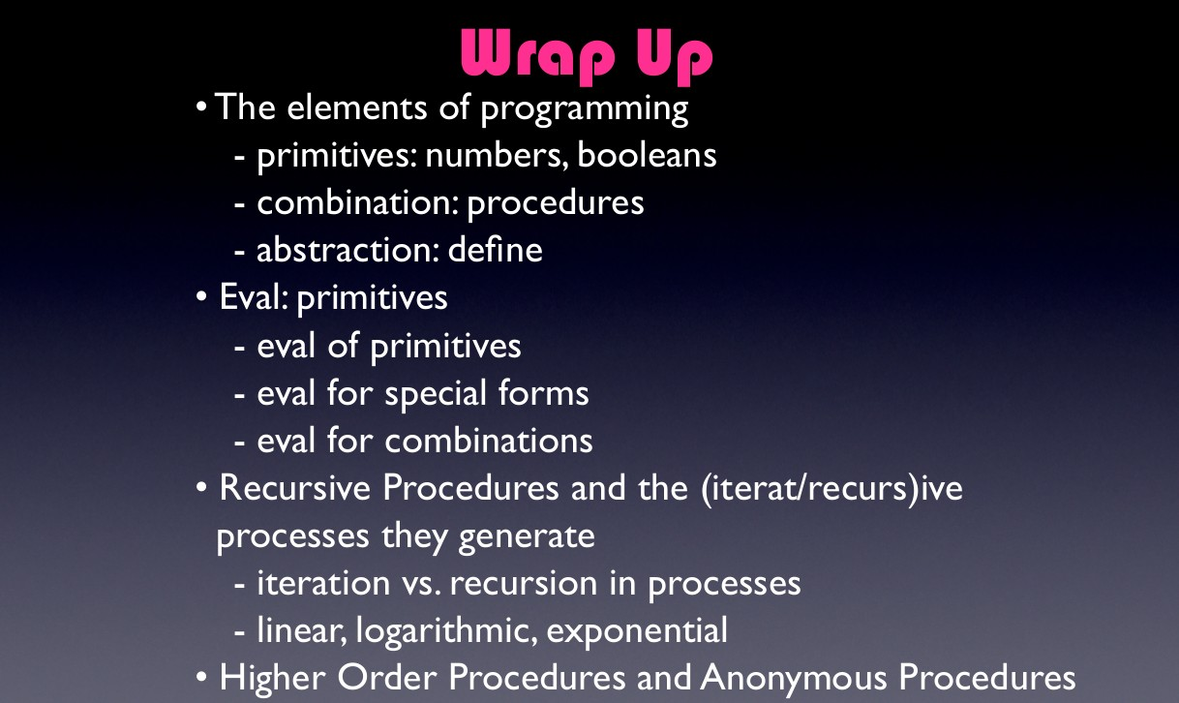

Slide 56
Define a procedure compose that implements the following composition
((compose square inc) 6)
49

Slide 57
(define (compose f g) (lambda (x) (f (g x))))

Slide 58
Define a procedure double that takes a procedure of one argument as argument and returns a
procedure that applies the original Procedure twice

Slide 59
(define (double f)
(lambda (x) (f (f x))))

Slide 60
What value is returned by
((double (double (double inc))) 5)

Slide 61
What value is returned by
(((double (double double)) inc) 5)

